Slide 1
Array Manipulation
Tutorial #26

Slide 2
OBJECTIVE

Slide 3
Objective
An array is an object. Here, you will learn some of the cornerstone functions used in manipulating it.

Slide 4
TEXTPLANATION

Slide 5
Textplanation
An array is an object. As such, it has its own properties and functions.

Slide 6
Textplanation
Many of the properties and functions of an array mimic those of strings. That should make sense to you because, if you think about it, a string is really just an array of characters.

Slide 7
Textplanation
Though arrays have a lot of functions, the following is a list of the ones that help you to add and remove items. You should take some time to review the rest of the functions on w3schools.com.
length gives you the number of items in the array.
push() adds an item to the end of the array.
unshift() adds an item to the beginning of the array.
pop() removes the last item from the array and returns it.
shift() removes the first item from the array and returns it.

Slide 8
Textplanation
The splice() function can be used to add and remove items from an array. It takes 2 or more parameters.
splice (startIdx, numToDelete, itemToInsert1, itemToInsert2, …, itemToInsertn)
The startIdx is the index in the array where you want the function to start working.
The numToDelete parameter tells the function how many items to pull out of the array, starting with the item at startIdx.
The item(s)ToInsert are items that you are adding to the array starting at startIdx. You can list as many item(s)ToInsert as you like, or none at all.

Slide 9
CONSTRUCTION

Slide 10
Construction
Create a folder somewhere on your drive and label it Array Manipulation.
Open up notepad++.
Save the empty file to your folder and name the file “index.html”.
All first pages on a website are called index.
You will also need columns.css for this construction.
As you go through the images of the construction, add to your code. You will see comments with explanations of what you are doing. Those comments will change with each slide. You should not type my comments into your code.

Slide 11
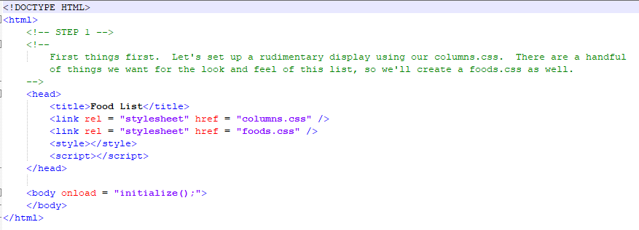
Construction

Slide 12
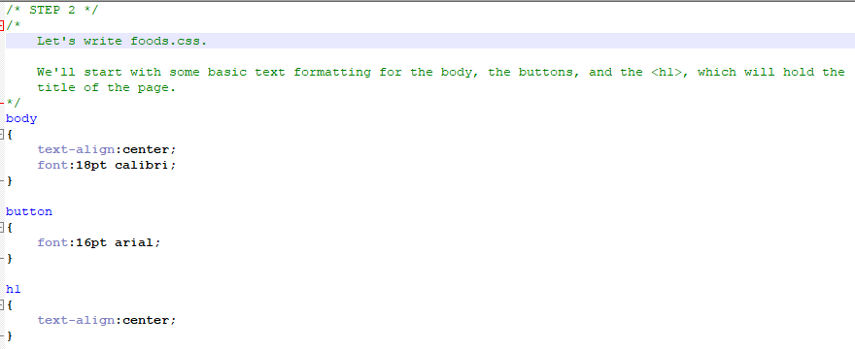
Construction

Slide 13
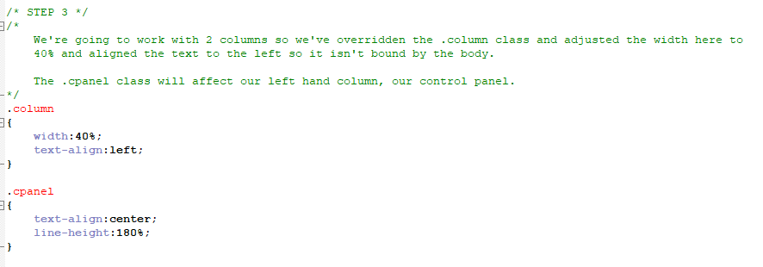
Construction

Slide 14
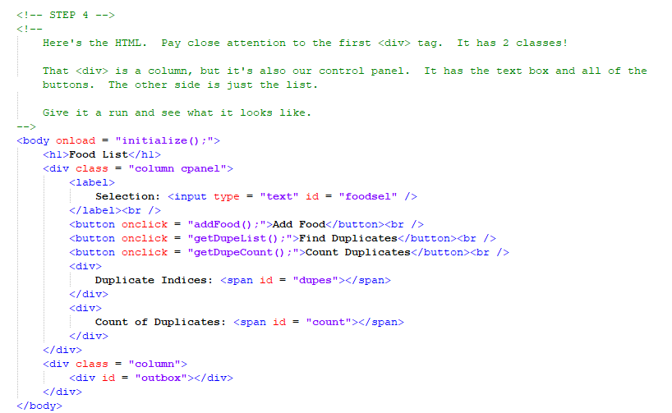
Construction

Slide 15
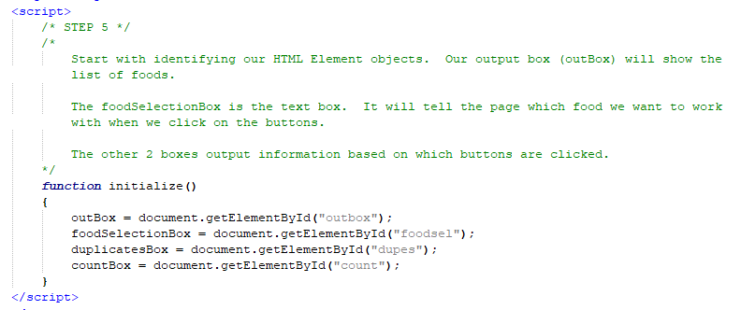
Construction

Slide 16
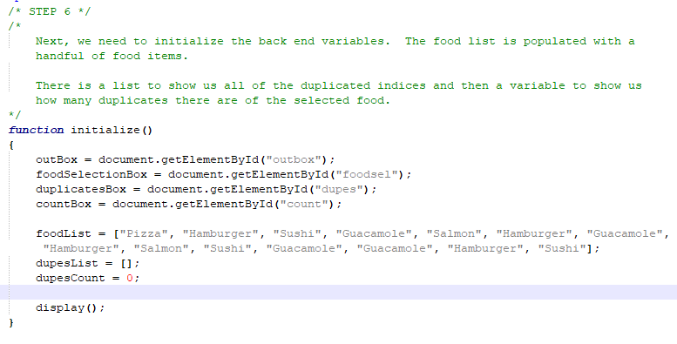
Construction

Slide 17
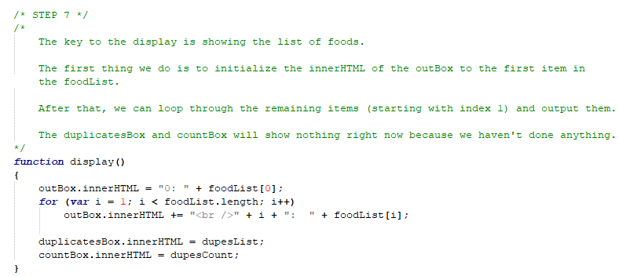
Construction

Slide 18
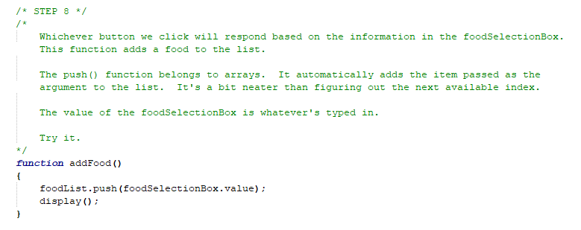
Construction

Slide 19
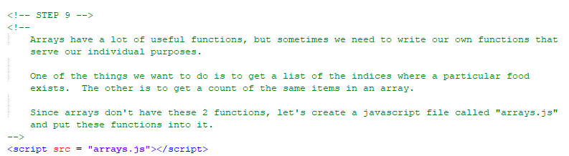
Construction

Slide 20
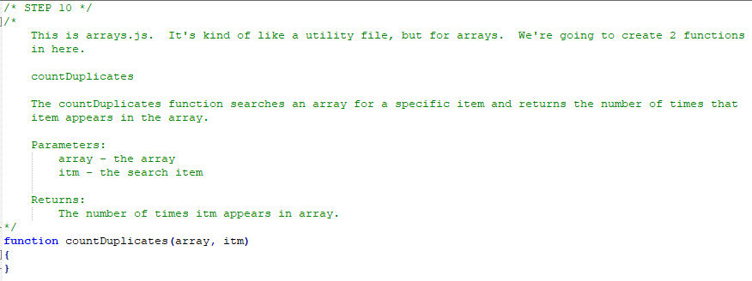
Construction

Slide 21
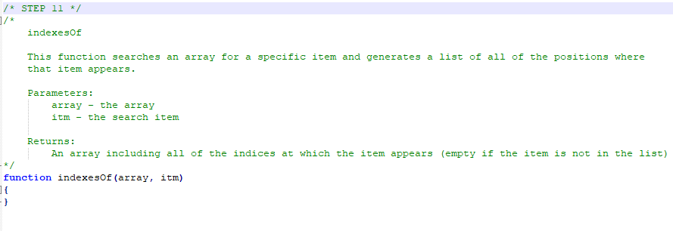
Construction

Slide 22
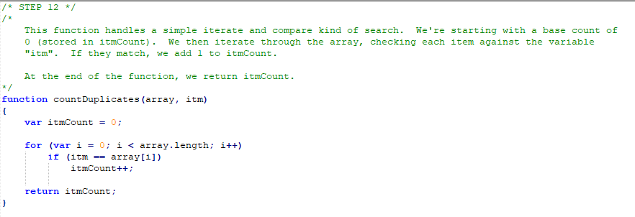
Construction

Slide 23
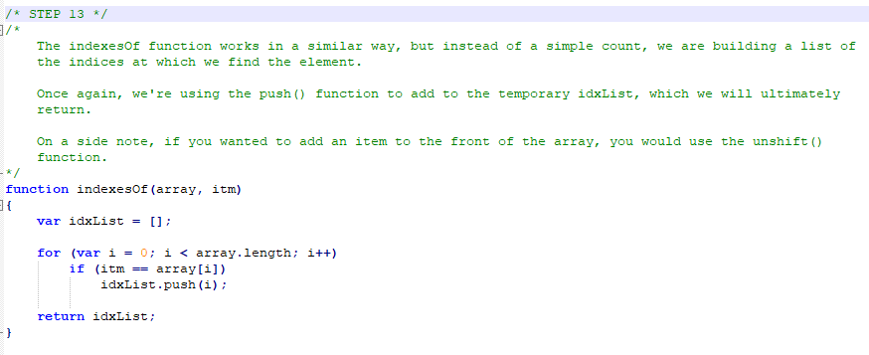
Construction

Slide 24
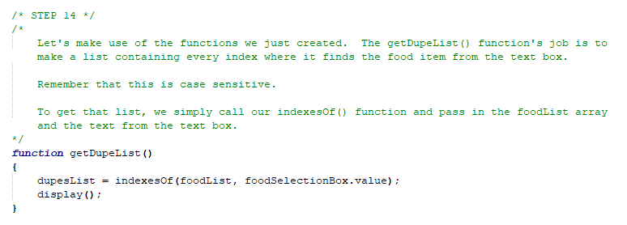
Construction

Slide 25
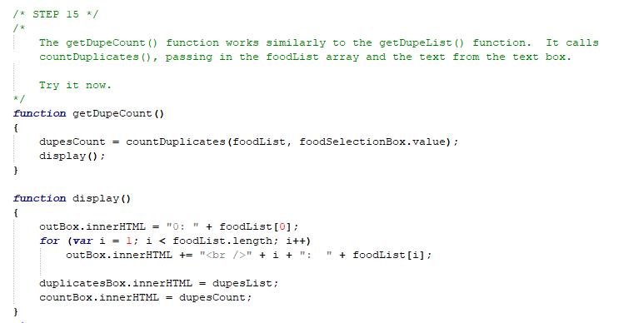
Construction

Slide 26
A DEEPER MEANING

Slide 27
A Deeper Meaning
Elements on a page are broken up into what's called Node Lists. The document keeps an array of all of the HTML elements inside of it. Each element inside the document does the same.

Slide 28
A Deeper Meaning
There is a function called getElementsByTagName() that works similarly to getElementById() except that it will search for all of the elements of a specific tag type and return a list of them. You can call this function using the document object or by using any other element on the page.

Slide 29
A Deeper Meaning
This is tremendously useful if you have a group of HTML Elements that you need to alter dynamically. Rather than having to assign ids to all of them, you can grab hold of them as a group in back end array.

Slide 30
A Deeper Meaning
In addition the getElementsByTagName(), there is also a function called getElementsByClassName() which has a similar result.

Slide 31
FAQ

Slide 32
FAQ
How does the sort() function work?
The sort() function, among others that belong to arrays, may rely on another function to tell it how to work. In Javascript, functions are objects and their code can be executed with the purpose of informing another piece of code how or when to work. You’ll learn more about that as you approach Level 4.

Slide 33
FAQ
Why doesn’t the reverse() function work?
The reverse() function works. As with many string functions, arrays have functions that create a temporary duplicate of the array, alter the duplicate, and return the duplicate. This is a safe way to handle altering objects.

Slide 34
ACTIVITY

Slide 35
Grocery List
In keeping with the “food” theme, write a grocery list page that allows a user to add and organize food items.
The page should have 3 sections.
Section 1 should have a text box where the user can enter in a grocery item and a button. Clicking the button adds the grocery item to the list.
Section 2 is the list itself. It consists of a numbered display showing all of the items in the list. This display should update every time the user adds a new item or moves an item.
Section 3 is the control panel and should have a text box so that the user can specify an item by number. There should be 3 “buttons” on the control panel. One button moves the selected item physically up the list (the index decreases by 1). Another button moves the item physically down the list (the index increases by 1). The third button removes the item from the list altogether.

Slide 36
Grocery List
When moving an item up or down, swap it with the item in the new position. For example, if the user wants to move item #2 up, it will change places with item #1.
Make sure that the user cannot move an item off of the list. For example, if the user selects item #0 and chooses to move it up (to slot -1), that should do nothing.
When deleting an item from the list, you will use the splice() function.

Slide 37
Grocery List
Bonus
Code the “Add” button so that, when the user clicks it, it adds the item to the list and clears the text box.
Code the up and down buttons so that the index inside the text box changes as you move the button, keeping the index pointing to the same item as it is moved.

